Slide 1
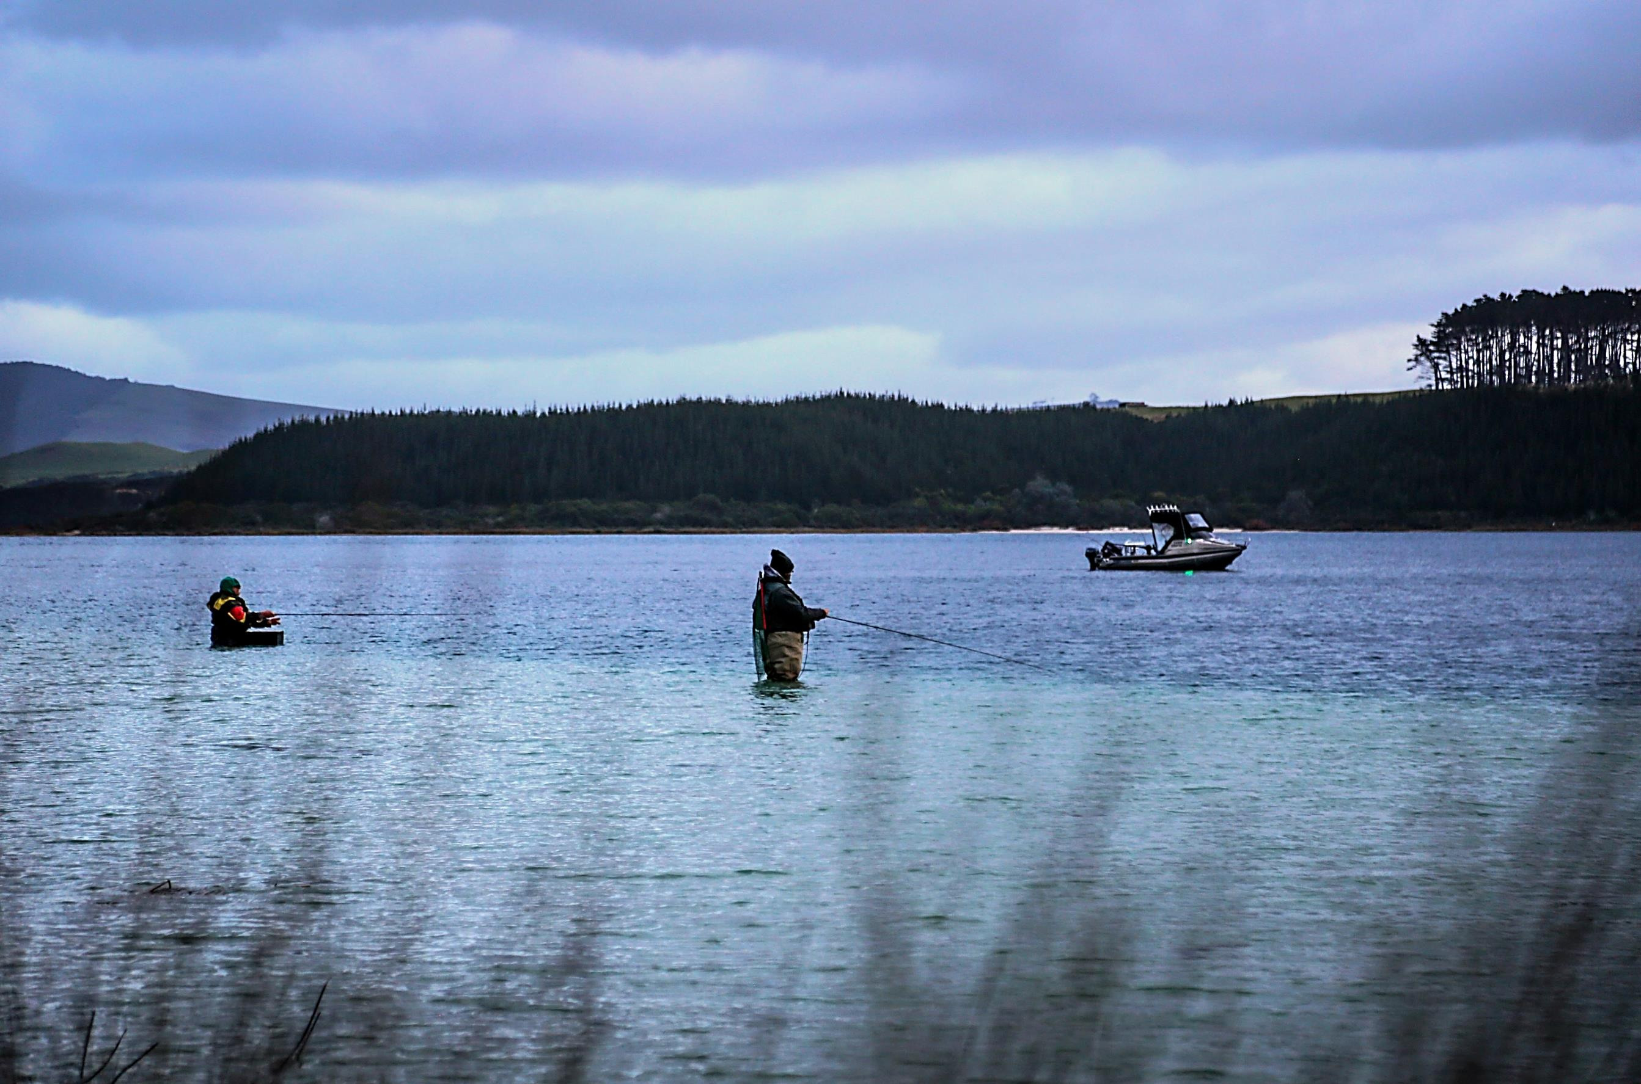














2018 Kai Iwi Lakes
Trout Fishing Competition
Adult $50.00
Junior & Children FREE entry.
Special conditions
apply.
7th and 8th July 2018
Registration Forms:
Available from Northland Fish & Game
McCoy & Thomas Dargaville,
Nolas Sports Dargaville
Hunting & Fishing Okara Drive, Whangarei https://fishandgame.org.nz/northland/events/
Accommodation
Bookings for camping can be made directly at Kai Iwi Lakes Campground
Ph: 09 439 0986 or email: lakes@kaipara.govt.nz Come for a great weekend of fun

Slide 2

29 May 2018
Dear Angler
The 2018 Kai Iwi Lakes Trout Fishing competition is organised for the 7th and 8th July 2018.
Ticket sales are now available from the following outlets:
Northland Fish & Game Council office, Whangarei
Hunting & Fishing OKARA DRIVE, Whangarei
McCoy & Thomas, Dargaville
Nolas Sports, Dargaville.
The price of tickets is:
Adults $50.00
Juniors FREE
Children FREE
As part of the kids fishing programme, juniors and children will be free to enter the competition but they must register for the competition and be accompanied by an adult.
The competition headquarters will be at the old Kai Iwi Lakes Water Ski Club, now known as the Lake Waikare Education Centre. Tickets will be available at these headquarters on Saturday morning, 7th July 2018.
As always there will be a great selection of prizes up for grabs and a number of spot prizes. A barbeque lunch will be provided at the completion of the fishing competition on Sunday, 8th July. Viking Kayaks have again sponsored another kayak. This kayak will be drawn as a lucky draw at the end of the competition.
Please find attached the flyer and fishing regulations for the competition.
Please note the “USE OF BOATS” on the flyer (see 9.1) Anglers MUST abide the ruling on not exceeding 5 knots within 200 metres of the shoreline.
The actual ruling which stands at present is that:
Anglers trolling from boats must stay at least 50m from any anglers fishing from the shore. Power boats are allowed on Lake Waikare but cannot exceed 5 knots on any part of the lake.
Powerboating on Lake Taharoa is allowed and all vessels can only exceed 5 knots 200 metres from the shoreline.
We look forward to seeing you and your family and friends at this year’s competition.
Regards
The Team at Northland Fish & Game Council
09 438 4135

